Slide 1
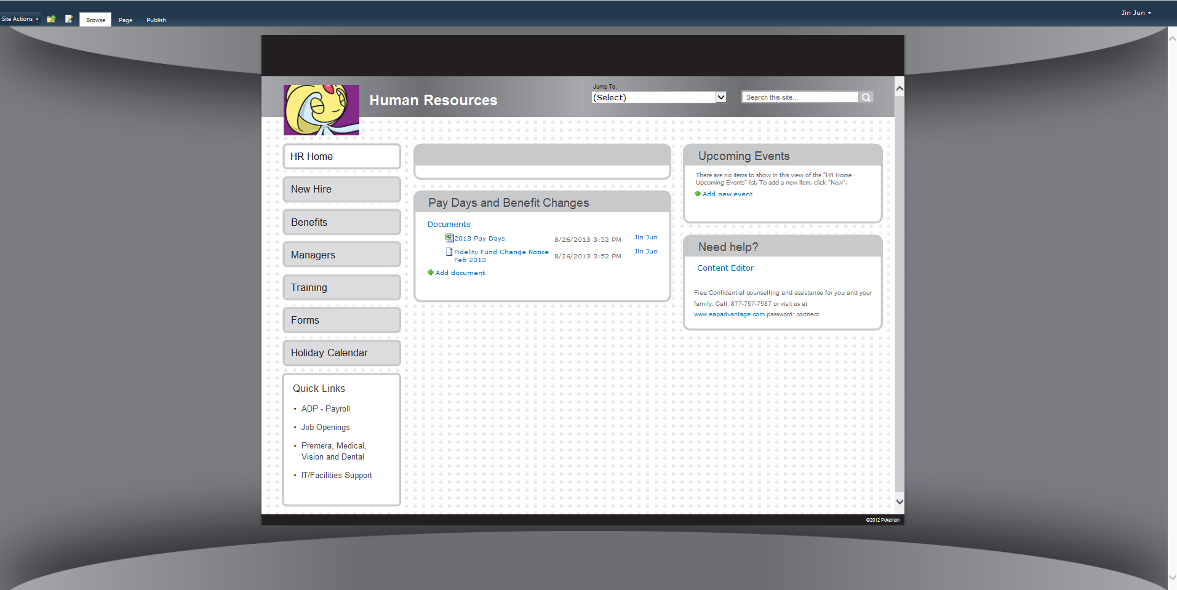
Pokemon HR SharePoint Portal Develpoment
The Challenge
The international media franchise Pokemon came to Affirma with a request to build an internal SharePoint site to support their HR department. The site needed to be able to manage HR functions such as onboarding, benefit documentation and process management, and provide a repository for training and recruitment information, policies and forms, and a holiday calendar. The site also needed to display filtered content based on the user, which required custom code in order to function within the required specifications.
What We Did
<ul>
<li>Took the client’s existing SharePoint 2010 site and built an intranet sub site based on their specific requirements.</li>
<li>Wrote custom Javascript to construct specialized features within the site and make the user interface easy to interact with.</li>
<li>Created a unique user experience design in Illustrator and implemented a reusable site layout, which the client can cost-effectively reuse to create additional sub sites.</li>
<li>Designed a unique filtering system within the site that adjusts content based on specific user groups. An administrator of the site assigns users to groups based on characteristics such as geographic location, and then the content is filtered and available to users based on their assigned group.</li>
<li>Did testing, bug fixes, and continued support in the post-product release period to ensure all of the client’s requests were met.</li>
</ul>
Results
The site launched smoothly and is live and running in two continents. The client was happy with the final product and has worked with Affirma on a number of projects since.

